Slide 1
Où Allons – Nous?
Un Livre Par _____________________________________________

Slide 2
_______________________________________
Je ______________________________________________________
Je ______________________________________________.
1.

Slide 3
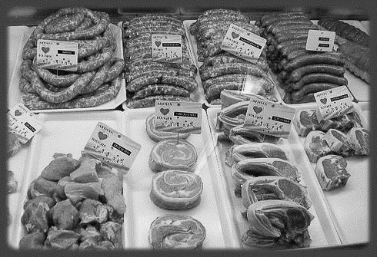
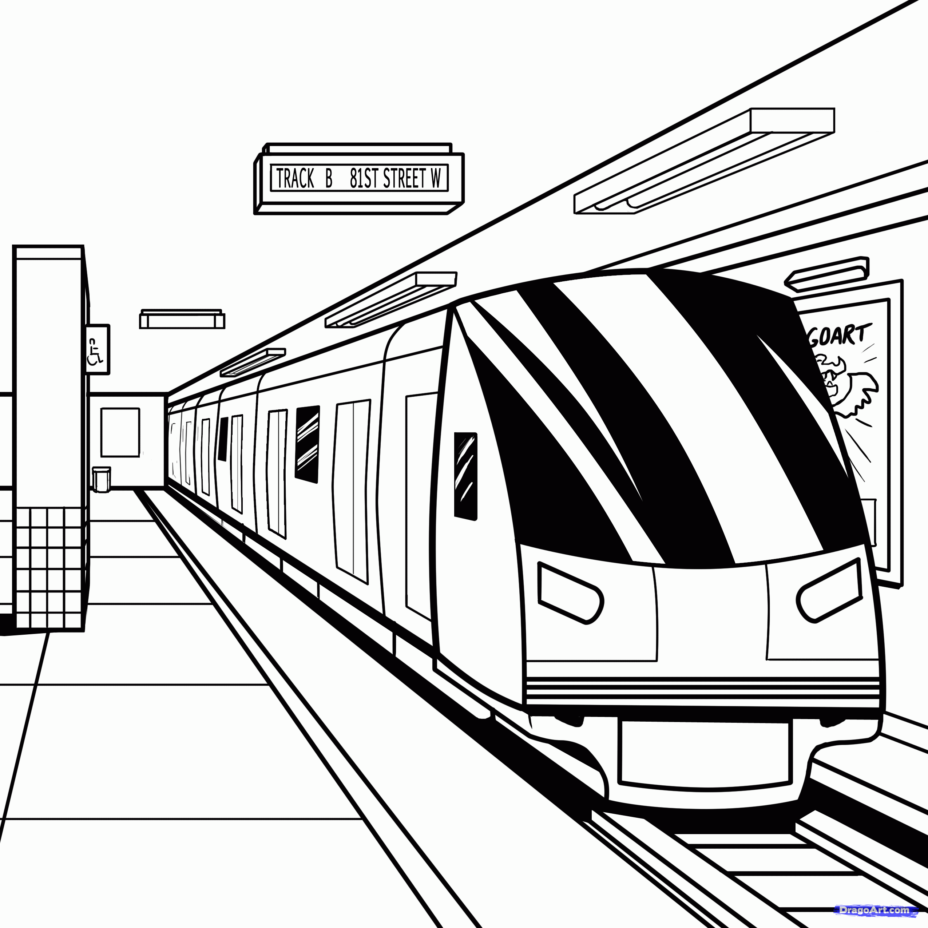
___________________________________________
Tu ____________________________________________.
Tu ___________________________________________.
2.

Slide 4
_________________________________________________
Elle _____________________________________________.
Elle ________________________________________.
3.

Slide 5
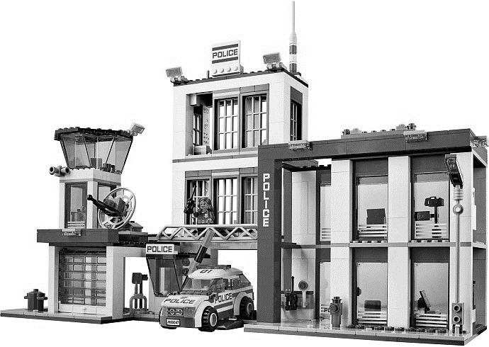
_________________________________________________
On ____________________________________________________.
On ________________________________________________.
4.

Slide 6
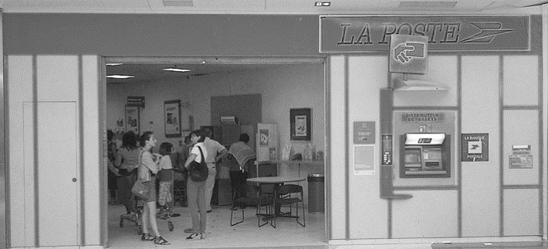
________________________________________________
Nous _________________________________________.
Nous ________________________________________.
5.

Slide 7
__________________________________________________________
Vous __________________________________________.
Vous _______________________________________.
6.

Slide 8
______________________________________________________
Ils ______________________________________________________.
Ils ____________________________________________________.
7.

Slide 9
___________________________________________________________
Elles __________________________________________________.
Elles _______________________________________________.
8.

Slide 10
Je m’appelle____________________________________
Classe A B
Neatness /5 There are drawing on pages 6, 7, & 8 /6
Spelling /10 Drawings are colored
on pages 6, 7, & 8 /6
Listed a place in
French on each page /8 Project handed in on time /3
Correct use of au, à la Name and Class letter on grading sheet /2
after aller in sentences /8
Name on cover of project /2
1st sentence on each page uses correct
grammar/aller form /8 La Note /66
2nd sentence on each page uses correct
grammar/aller form
and transportation /8

