Slide 1
¿Adónde Vamos?
Un Libro de_____________________________________________

Slide 2
_______________________________________
Yo ____________________________________________________
Yo ____________________________________________.
1.

Slide 3
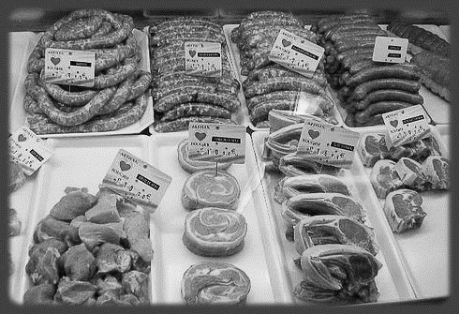
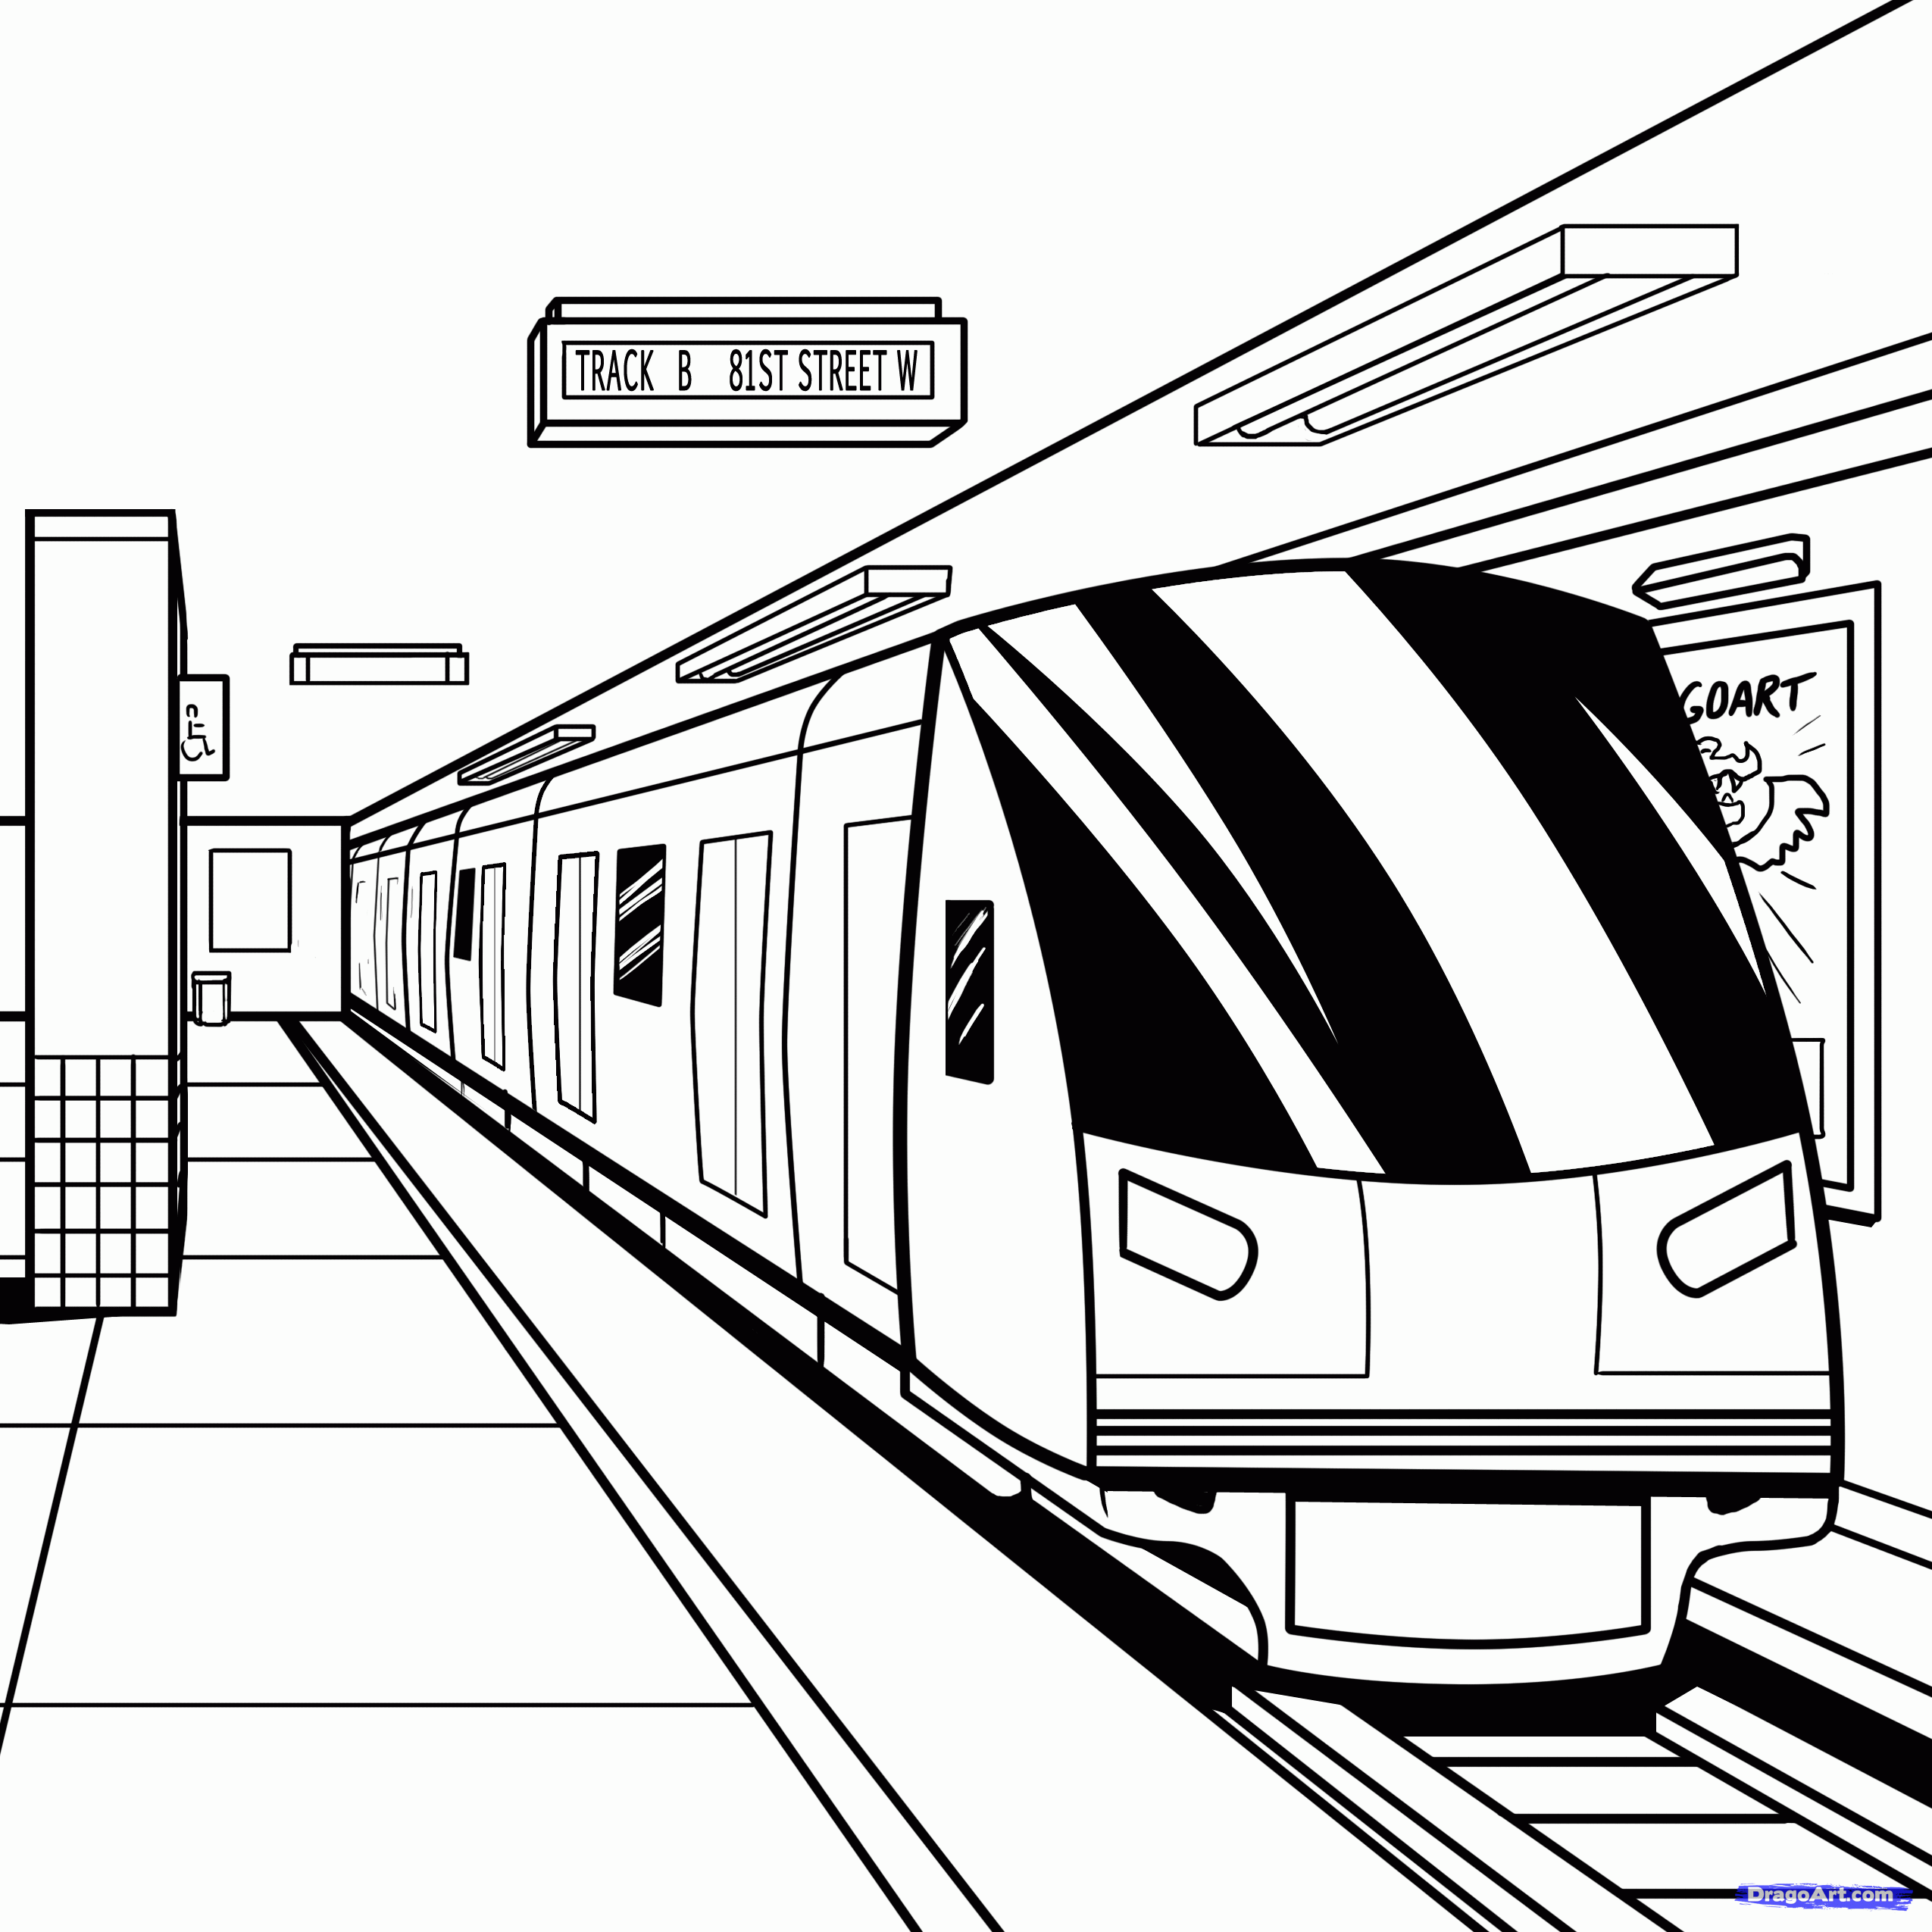
___________________________________________
Tú ____________________________________________.
Tú ___________________________________________.
2.

Slide 4
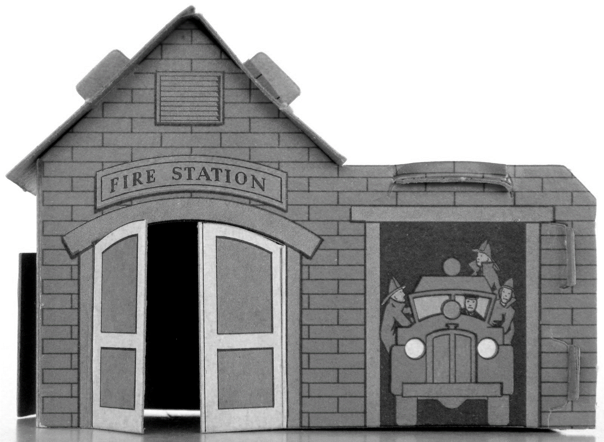
_________________________________________________
Ella _____________________________________________.
Ella ________________________________________.
3.

Slide 5
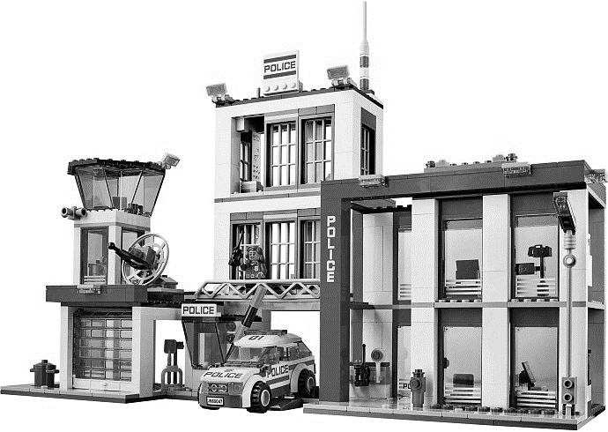
_________________________________________________
Ud. ____________________________________________________.
Ud. ________________________________________________.
4.

Slide 6
________________________________________________
Nosotros _________________________________________.
Nosotros ________________________________________.
5.

Slide 7
__________________________________________________________
Vosotros __________________________________________.
Vosotros _______________________________________.
6.

Slide 8
______________________________________________________
Ellos ______________________________________________________.
Ellos ____________________________________________________.
7.

Slide 9
___________________________________________________________
Ellas __________________________________________________.
Ellas _______________________________________________.
8.

Slide 10
Me llamo____________________________________
Clase C D E
Neatness /5 There are drawing on pages 6, 7, & 8 /6
Spelling /10 Drawings are colored
on pages 6, 7, & 8 /6
Listed a place in
Spanish on each page /8 Project handed in on time /3
Correct use of al, a la Name and Class letter on grading sheet /2
after IR in sentences /8
Name on cover of project /2
1st sentence on each page uses correct
grammar/ir form /8 La Nota /66
2nd sentence on each page uses correct
grammar/ir form
and transportation /8

