Slide 1
GEOGRAPHY REVIEW
Part 1 – Civilizations, States, and Empires

Slide 2
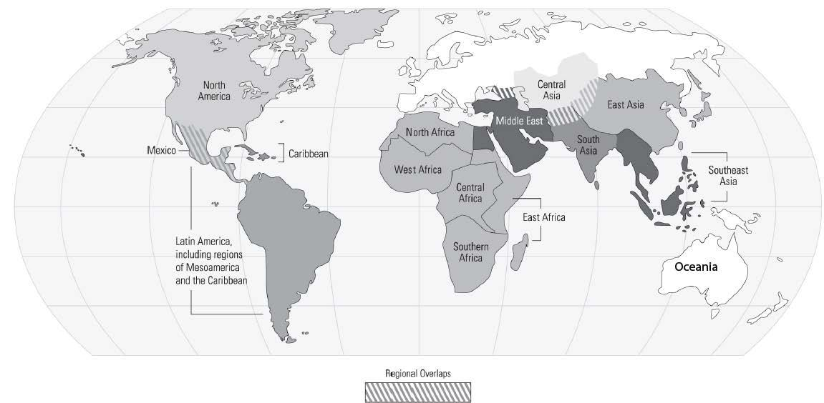
Period 1 Civilizations
Egypt
Shang/Zhou
Mesopotamia
Indus
Chavin
Olmec

Slide 4
Period 2 Civilizations
Greek city-states
Roman Empire
Persian Empire
Mauryan & Gupta Empires
Mayan
Qin & Han

Slide 6
Period 3 Civilizations
Byzantine
Sui/Tang/Song
Aztec Empire
Swahili City-States
Feudal Europe
Mongol Empire
Inca Empire
Ghana/Mali
Caliphates
Kievan Rus

Slide 7
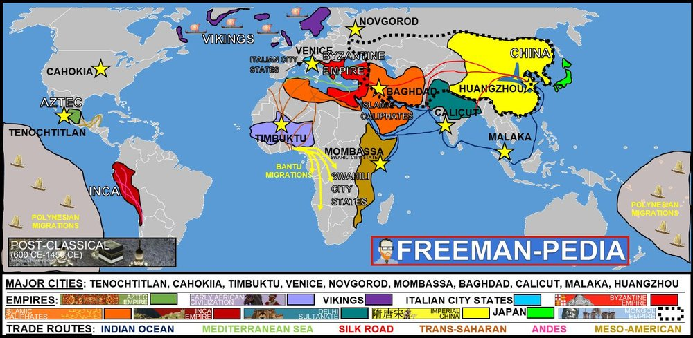

Slide 8
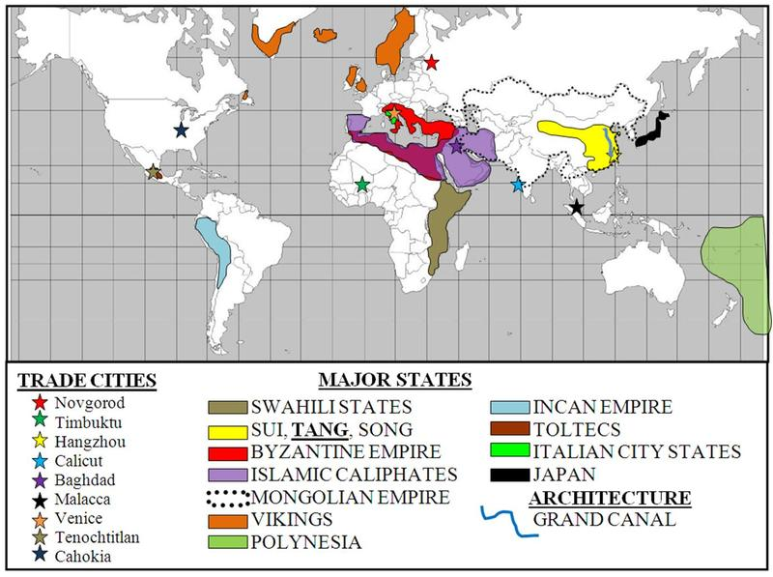

Slide 9
Period 4 Empires
Ottoman
Ming/Qing
Portuguese Empire
Dutch Empire
Mughal
Tokugawa
English Empire
Russian
Spanish Empire
French Empire

Slide 10
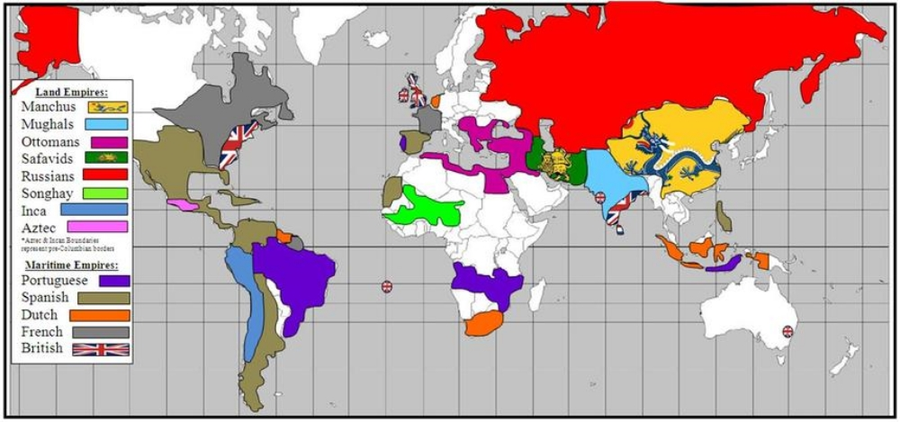

Slide 11
Period 5 Empires
Ottoman
Qing
Belgian Empire
Russian
British Empire
German Empire
Meiji
French Empire
Spanish Empire

Slide 12
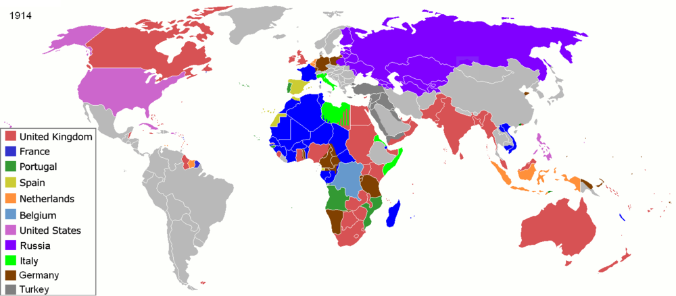

Slide 13
GEOGRAPHY REVIEW
Part 2 – Geography by Time Period

Slide 14
600CE-1450CE
Feudalism
Gold-Salt
Battle of Tours
Triangular Trade
Bubonic Plague
Mongols
Rise of Islam
Achaemenids
Boxer Rebellion
Quipu
Roman Republic
Satrapies
Crusades
Xiongnu
Aztec Empire
Ibn Battuta
Industrial Rev.
Sultanate Delhi
Neo-Confucianism
Reformation
Cold War
Trans-Saharan Trade
East-West Schism
Daimyo
Enlightenment
Grand Canal
Vikings
Ashoka
Mali
Fast-Ripe Rice
Chinampas
Gupta
Zheng He

Slide 15
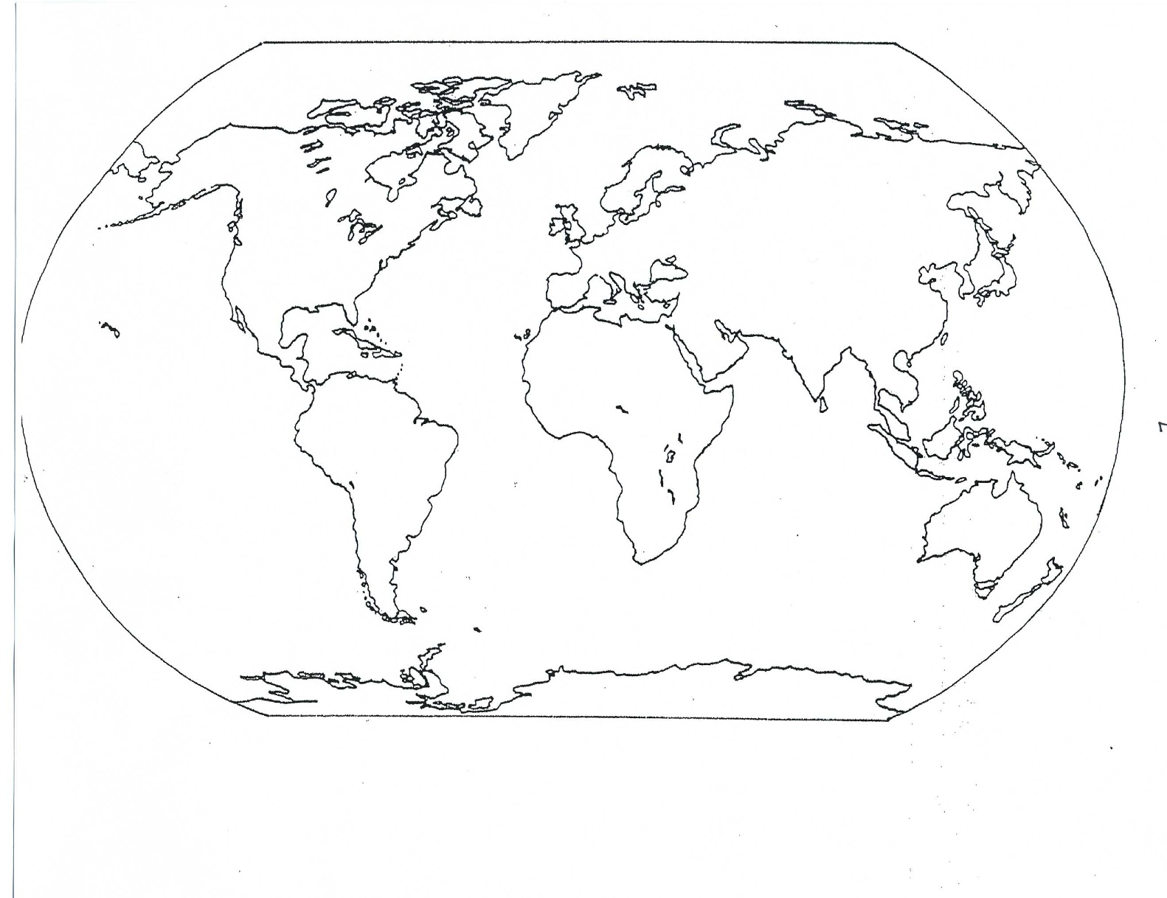
Feudalism
Battle of Tours
Vikings
East-West Schism
Crusades
Mongols-Bubonic Plague
Ibn Battuta
Daimyo
Feudalism
Aztec Empire
Chinampas
Rise of Islam
Delhi Sultanate
Neo-Confucianism
Fast-Ripe-Rice
Grand Canal
Zheng He
Quipu
Gold-Salt
Trans-Saharan
Mali

Slide 16
1900-Present
Korean War
Berlin Wall
Begin Industry
5 yr Plans
Missile Crisis
Long March
Sepoy Rebellion
Salt March
Sputnik
WWI Battle
Scramble for Africa
WWII Battle
Collectivization
De-Stalinization
Tanzimat Reform
Duma
Gandhi
Mughal
Khrushchev
Renaissance
Guomindang
Emilio Zapata
Superpower
Vietnam War
Green Rev Start
Jamaica Letter
Great Leap Forward
Mandates
Apartheid
Atlantic Revolution
A-bomb Dropped
Tiananmen Sq.
Suez Crisis
Emancipate Serfs
Island-hopping

Slide 17
5 Yr Plan
Long March
Collectivization
Guomindang
Great Leap Forw.
Tiananmen Sq.
Sputnik
Duma
De-Stalin
Krushchev
5- year plan
Collectivization
Superpower
WWI Battles
WWII Battles
Berlin Wall
Korean War
Superpower
Mandates
Suez Crisis
A-Bombs
WWI & WWII Battles
WWII Battles
Island-Hop
Emilio Zapata
Missile Crisis
Vietnam War
Salt March
Gandhi
Green Rev. St
Apartheid

Slide 18
1450CE-1750CE
Manchu
Creole Elites
Abbasid Caliphate
Columbian Exchange
Plantation Economies
Medieval Europe
Reformation
New Ethnic Groups
Renaissance
Wood-Block Prints
Sultanate of Delhi
Devshirme
Westernization
30 Year War
Mercantilism
Mughal
Vikings
Songhai
Global flow of silver
British East India Company
Crusades
Triangular Trade
Boxer Rebellion
Atlantic Slave Trade
Piracy
Charlemagne
Fall of Constantinople
Absolute Monarchs
Equal-Field System

Slide 19
Renaissance
Reformation
30 yr War
Mercantilism
Ab. Monarchs
Westernization
Wood-Block Prints
Triangular Trade
Atlantic Slave
Columbian Ex.
Fall of Const.
Devshirme
Piracy
Manchu
Songhai
Creole Elites
Planation Econ
New Ethnic Gp
Mughal
British E.India Comp
GLOBAL FLOW OF SILVER

Slide 20
1750CE-1900CE
Aztec Empire
Begin Industrialization
Enlightenment
Spheres of Influence
Taj Mahal Built
Gov’t sponsored Industrialization
Sepoy Rebellion
Scramble for Africa
Taiping Rebellion
Ming Dynasty
Meiji Reformation
Sick Man of Europe
Great Depression
Unification of Germany
Trans-Siberian Railroad
Mercantilism
Settler Colonies
Revolutions
Opium Wars
Martin Luther
Tanzimat Reforms
Raw Material Export
Mandates
Economic Imperialism
Chinese Exclusion Acts
Mali Empire
Ashoka
Boxer rebellion
Japanese colonies

Slide 21
Begin Industry
Enlightenment
Fr.Revolution
Unif. Germany
Meiji Reformation
Gov’t Industry
Gov’t Industry
Trans-Siberian Rail
American Rev.
Chinese Exclu Act
Sick Man of Euro
Tanizmat Reform.
Spheres of Influen
Taiping Rebellion
Opium Wars
Boxer Rebellion
Econ Imperialism
Haiti Rev.
Settler Colony
Scramble for Af.
Raw Material Ex.
Econ Imperialism
Raw Material Ex.
Latin Revolution
Sepoy Rebellion
Japan Colonies Pacific Islands
Settler Colony
Settler Colony

Slide 22
600BCE-600CE
Caste System
Confucianism
Constantinople
Achaemenids
Bureaucracy of Merit
Neo-confucianism
City-States
Mongols
Satrapies
Crusades
Hellenistic Empires
Republic
Xiongnu
Equal-field system
Fall to Nomads
Jewish Diaspora
Qanat
Song Dynasty
Papermaking
Buddhism
Daoism
Aztec Empire
Silk Roads
Ashoka
East-West Schism
Mandate of Heaven
Mauryan
Rise of Islam
Caesaropapism
Germanic Tribes
Zheng He
Popular Hinduism
De-Stalinization

Slide 23
City-States
Republic
Jewish Diaspora
Germanic Tribes
Fall to Nomads
Constantinople
Caesaropapism
Confucianism
Bureau of Merit
Xiongnu
Fall to Nomads
Papermaking
Daoism
Mandate of Heaven
Buddhism after Han
SILK ROADS
City-States (Maya)
Achaemenids
Satrapies
Hellenistic Emp.
Qanat
Jewish Diaspora
Caste System
Fall to Nomads
Buddhism
Ashoka
Mauryan
Popular Hinduism

Slide 24
GEOGRAPHY REVIEW
Part 3 – Zooming in on Regions

Slide 25
What is the name of this land mass?
What AP World region is dotted?
What country is A?
What country is B?

Slide 26
What is the name of this land mass? AFROEURASIA
What AP World region is dotted? SOUTHEAST ASIA
What country is A? PHILIPPINES
What country is B? INDONESIA

Slide 27
X
X
5. What empire controlled this area between 500 and 1000 CE?
6. What empire controlled this area between 1500 and 1900 CE?
7. What is the current name of the city located at the X?

Slide 28
X
X
5. What empire controlled this area between 500 and 1000 CE? BYZANTINE EMPIRE
6. What empire controlled this area between 1500 and 1900 CE? OTTOMAN EMPIRE (Currently Turkey)
7. What is the current name of the city located at the X? ISTANBUL (formerly Constantinople)

Slide 29
8. What kind of government did “A” have between 500 and 1000?
9. Throughout history, has “D” been more centralized or decentralized?
10. What empire controlled “C” in Period 3?
11. What is the name of the peninsula labeled “B”?

Slide 30
8. What kind of government did “A” have between 500 and 1000? MONARCHY/FEUDALISM
9. Throughout history, has “D” been more centralized or decentralized? China has been more CENTRALIZED despite multiple periods of civil war/warring states
10. What empire controlled “C” in Period 3? UMAYYAD CALIPHATE, ABBASID CALIPHATE, MONGOL ILKHANATE
11. What is the name of the peninsula labeled “B”? ANATOLIA

Slide 31
12. What trade network does the solid line represent?
13. What trade network does the dashed line represent?

Slide 32
12. What trade network does the solid line represent? INDIAN OCEAN TRADE NETWORK
13. What trade network does the dashed line represent? SILK ROADS

Slide 33
14. What do the arrows represent?
15. What time period did this take place in?

Slide 34
14. What do the arrows represent? (PRIMARILY) ATLANTIC SLAVE TRADE
15. What time period did this take place in? MOSTLY PERIOD 4 (1450 – 1750) into Period 5

Slide 35
16. a. Does this map represent trade before or after 1500 CE?
b. How do you know?
17. What trade network does the blue circle represent?

Slide 36
16. a. Does this map represent trade before or after 1500 CE? BEFORE 1500
b. How do you know? NO INCLUSION OF AMERICAS
17. What trade network does the blue circle represent? TRANS-SAHARAN TRADE NETWORK

Slide 37
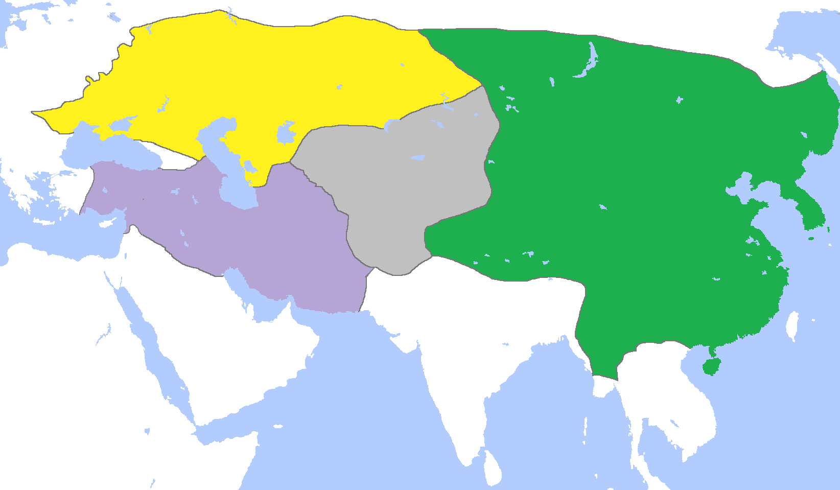
18. a. What empire does this map represent?
b. What do the colors indicate?
c. What is the name of the yellow-ish area?

Slide 38
18. a. What empire does this map represent? MONGOL EMPIRE
b. What do the colors indicate? KHANATES DIVIDED AMONGST 4 MONGOL RULERS
c. What is the name of the yellow-ish area? GOLDEN HORDE

Slide 39
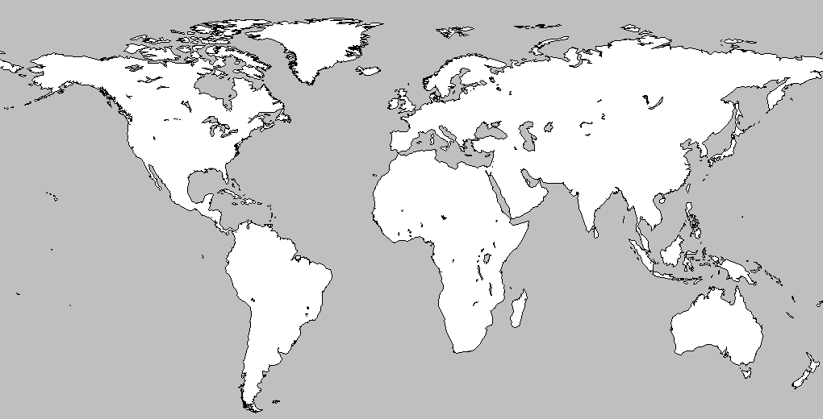
A
B
19. What trade route was centered on location “A”?
20. What is located at “B” today?

Slide 40
A
B
19. What trade route was centered on location “A”? COLUMBIAN EXCHANGE
20. What is located at “B” today? SUEZ CANAL

