Slide 1
Images of AP World

Slide 2
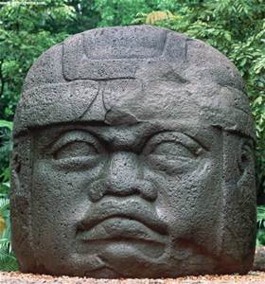
AP says YOU need to know
1
What society/culture is this from?
Where is that society located?
What does it represent?
When was it created?

Slide 3
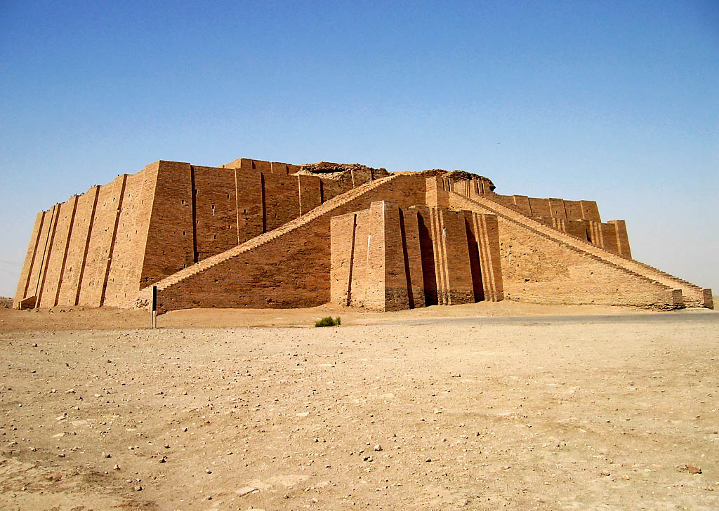
AP says YOU need to know
2
What society/culture is this from?
Where is that society located?
What does it represent?
When was it created?

Slide 4
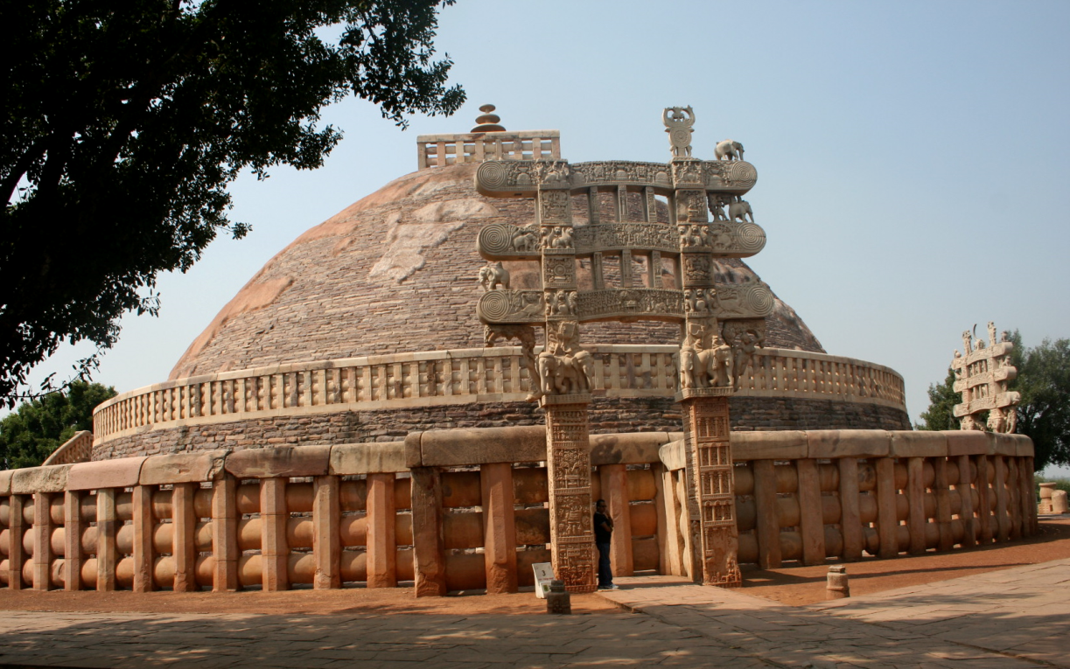
AP says YOU need to know
3
What society/culture is this from?
Where is that society located?
What does it represent?
When was it created?

Slide 5
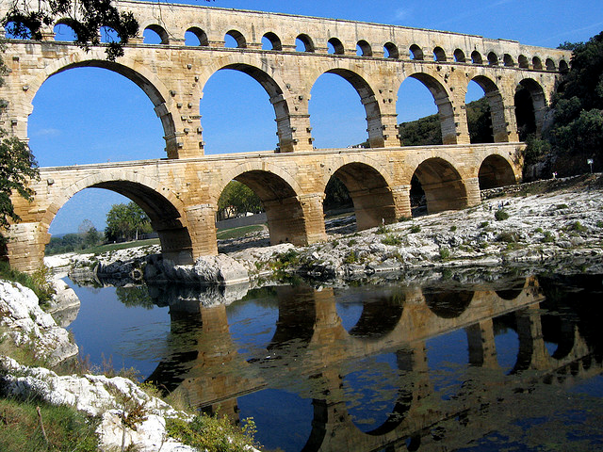
AP says YOU need to know
4
What society/culture is this from?
Where is that society located?
What does it represent?
When was it created?

Slide 6
AP says YOU need to know
5
What society/culture is this from?
Where is that society located?
What does it represent?
When was it created?

Slide 7
AP says YOU need to know
6
What society/culture is this from?
Where is that society located?
What does it represent?
When was it created?

Slide 8
AP says YOU need to know
7
What society/culture is this from?
Where is that society located?
What does it represent?
When was it created?

Slide 9
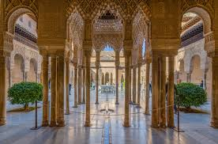
AP says YOU need to know
8
What society/culture is this from?
Where is that society located?
What does it represent?
When was it created?

Slide 10
AP says YOU need to know
9
What society/culture is this from?
Where is that society located?
What does it represent?
When was it created?

Slide 11
AP says YOU need to know
10
What society/culture is this from?
Where is that society located?
What does it represent?
When was it created?

Slide 12
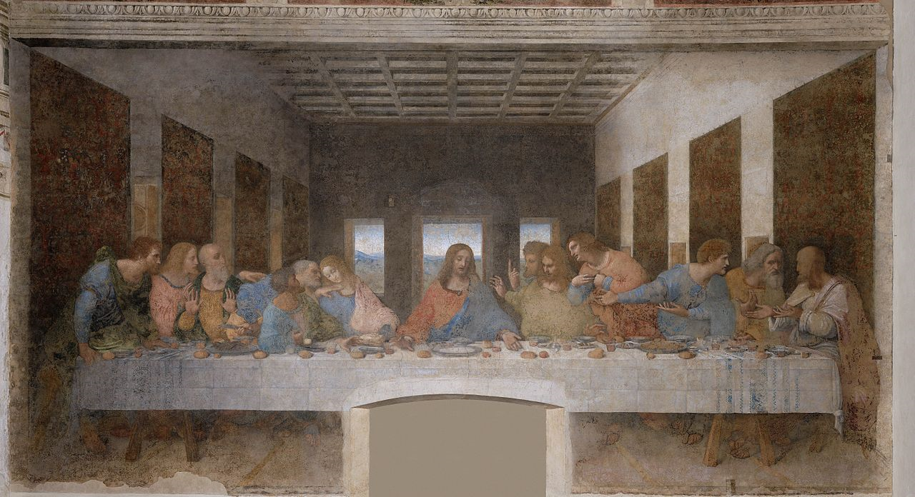
AP says YOU need to know
11
What society/culture is this from?
Where is that society located?
What does it represent?
When was it created?

Slide 13
AP says YOU need to know
12
What society/culture is this from?
Where is that society located?
What does it represent?
When was it created?

Slide 14
AP says YOU need to know
13
What society/culture is this from?
Where is that society located?
What does it represent?
When was it created?

Slide 15
AP says YOU need to know
14
What society/culture is this from?
Where is that society located?
What does it represent?
When was it created?

Slide 16
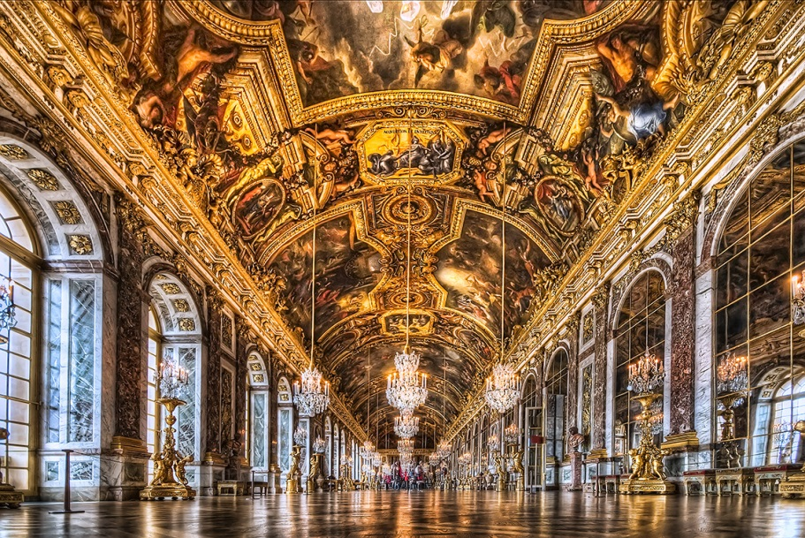
AP says YOU need to know
15
What society/culture is this from?
Where is that society located?
What does it represent?
When was it created?

Slide 17
AP says YOU need to know
16
What society/culture is this from?
Where is that society located?
What does it represent?
When was it created?

Slide 18
AP says YOU need to know
17
What society/culture is this from?
Where is that society located?
What does it represent?
When was it created?

Slide 19
AP says YOU need to know
18
What society/culture is this from?
Where is that society located?
What does it represent?
When was it created?

Slide 20
AP says YOU need to know
19
What society/culture is this from?
Where is that society located?
What does it represent?
When was it created?

Slide 21
AP says YOU need to know
20
What society/culture is this from?
Where is that society located?
What does it represent?
When was it created?

Slide 22
AP says YOU need to know
21
What society/culture is this from?
Where is that society located?
What does it represent?
When was it created?

Slide 23
AP says YOU need to know
22
What society/culture is this from?
Where is that society located?
What does it represent?
When was it created?

Slide 24
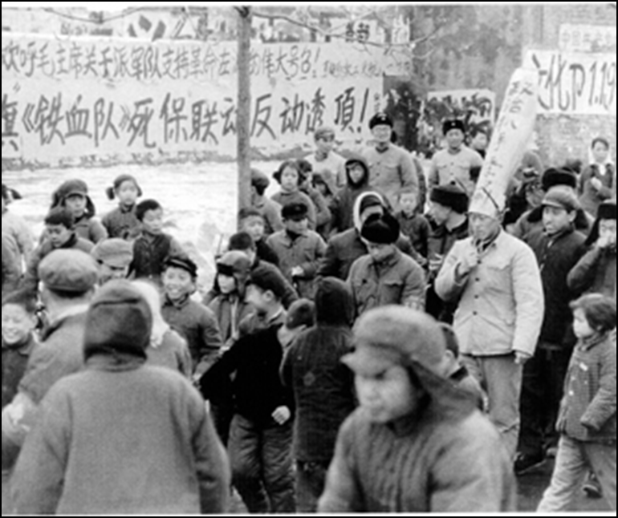
23
AP says YOU need to know
What society/culture is this from?
Where is that society located?
What does it represent?
When was it created?

Slide 25
AP says YOU need to know
24
What society/culture is this from?
Where is that society located?
What does it represent?
When was it created?

Slide 26
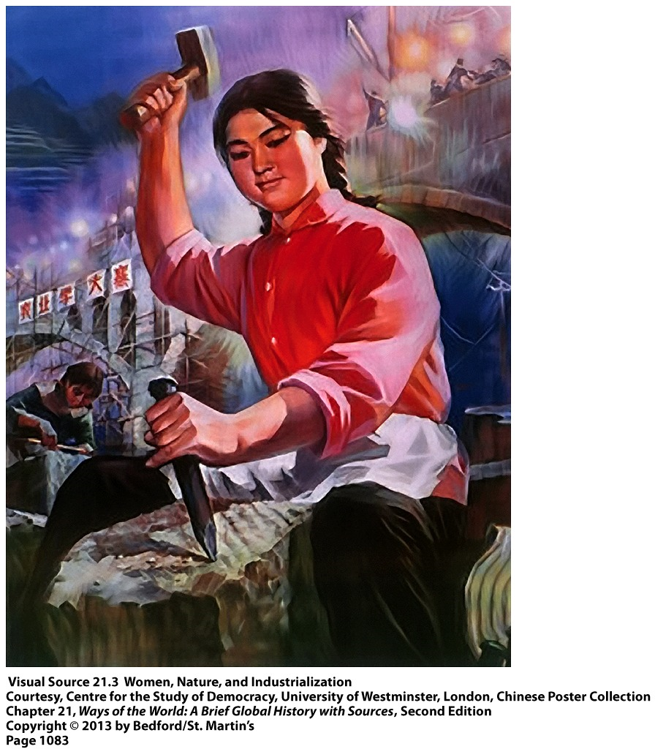
AP says YOU need to know
25
What society/culture is this from?
Where is that society located?
What does it represent?
When was it created?

Slide 27
AP says YOU need to know
26
What society/culture is this from?
Where is that society located?
What does it represent?
When was it created?

Slide 28
27
AP says YOU need to know
What society/culture is this from?
Where is that society located?
What does it represent?
When was it created?

Slide 29
AP says YOU need to know
28
What society/culture is this from?
Where is that society located?
What does it represent?
When was it created?

Slide 30
29
What society/culture is this from?
Where is that society located?
What does it represent?
When was it created?

Slide 31
AP says YOU need to know
30
What society/culture is this from?
Where is that society located?
What does it represent?
When was it created?

Slide 32
AP says YOU need to know
31
What society/culture is this from?
Where is that society located?
What does it represent?
When was it created?

Slide 33
AP says YOU need to know
32
What society/culture is this from?
Where is that society located?
What does it represent?
When was it created?

Slide 34
AP says YOU need to know
33
What society/culture is this from?
Where is that society located?
What does it represent?
When was it created?

Slide 35
34
AP says YOU need to know
What society/culture is this from?
Where is that society located?
What does it represent?
When was it created?

Slide 36
AP says YOU need to know
35
What society/culture is this from?
Where is that society located?
What does it represent?
When was it created?

Slide 37
36
AP says YOU need to know
What society/culture is this from?
Where is that society located?
What does it represent?
When was it created?

Slide 38
AP says YOU need to know
37
What society/culture is this from?
Where is that society located?
What does it represent?
When was it created?

Slide 39
AP says YOU need to know
38
What society/culture is this from?
Where is that society located?
What does it represent?
When was it created?

Slide 40
39
AP says YOU need to know
What society/culture is this from?
Where is that society located?
What does it represent?
When was it created?

Slide 41
AP says YOU need to know
40
What society/culture is this from?
Where is that society located?
What does it represent?
When was it created?

Slide 42
AP says YOU need to know
41
What society/culture is this from?
Where is that society located?
What does it represent?
When was it created?

Slide 43
AP says YOU need to know
42
What society/culture is this from?
Where is that society located?
What does it represent?
When was it created?

Slide 44
43
AP says YOU need to know
What society/culture is this from?
Where is that society located?
What does it represent?
When was it created?

Slide 45
AP says YOU need to know
44
What society/culture is this from?
Where is that society located?
What does it represent?
When was it created?

Slide 46
AP says YOU need to know
45
What society/culture is this from?
Where is that society located?
What does it represent?
When was it created?

Slide 47
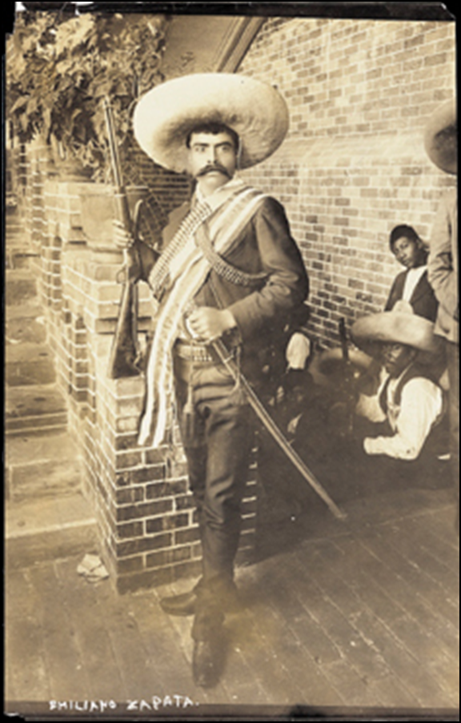
AP says YOU need to know
46

Slide 48
AP says YOU need to know
46

